Slide 1

Access & Discovery of Documentary Images
[ADDI]
A Platform for the Exploration and Critique of Computer Vision Algorithms
14 July 2023
T. ARNOLD & L. TILTON

Slide 2



Distant Viewing Lab
The Distant Viewing Lab uses and develops computational techniques to analyze visual culture on a large scale. It develops tools, methods, and datasets that can be re-used by other researchers. The lab engages closely with critical cultural and data studies, aiming to make explicit the interpretive act of algorithmic logic.
distantviewing.org
T. ARNOLD & L. TILTON

Slide 3

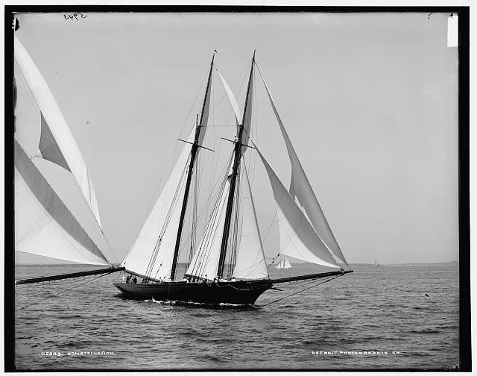
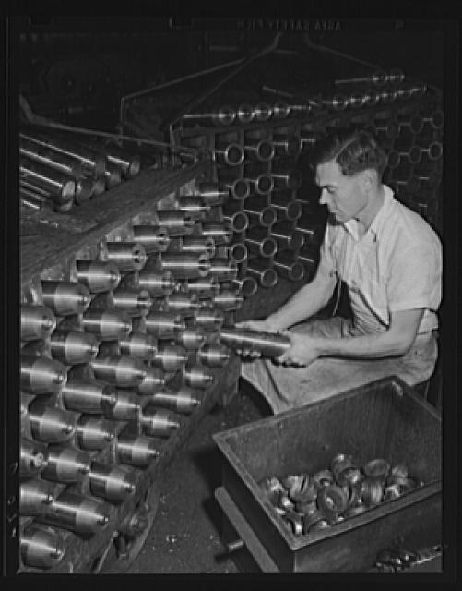
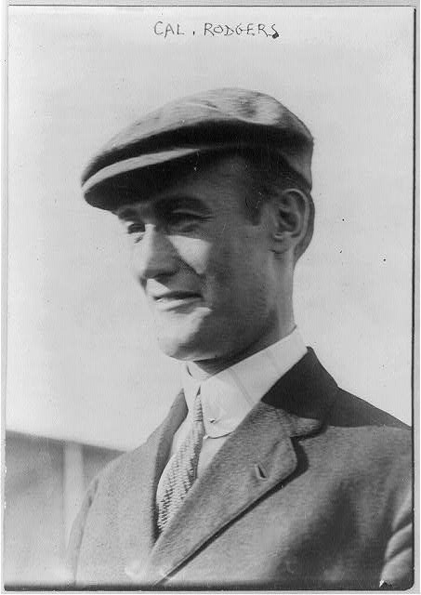
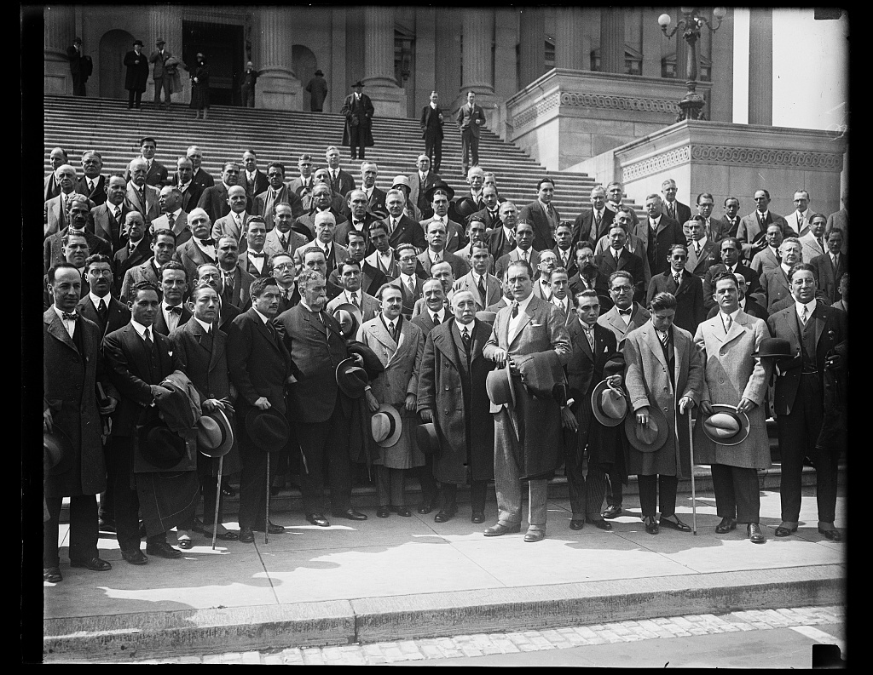
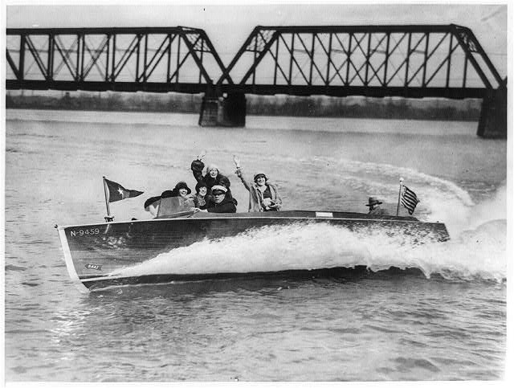
ADDI Platform
Work with the Library of Congress. A prototype study to how computer vision (CV) can increase access and discovery of digital photography collections. Using > 250k documentary photographs from the early 20th century.
– Open platform for the exploration of CV annotations.
– Qualitative assessment of CV applied to these historic collections.
Detroit Publishing Company
Farm Security Administration
Bain Collection
Harris & Ewing
National Photo Company Collection
T. ARNOLD & L. TILTON

Slide 4
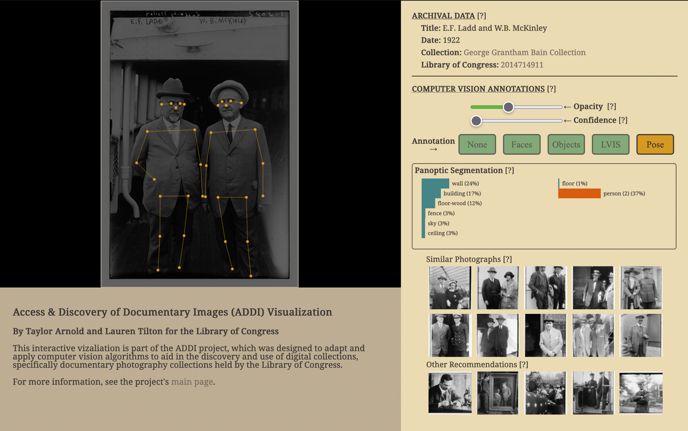
Visualisation Platform
User-centric design, considers different possibly communities and uses of the platform.
Built using the ideas of generous interfaces (Whitlaw), information density (Tufte), and data feminism (d’Ignazio and Klein).
tinyurl.com/2p8heby3
T. ARNOLD & L. TILTON

Slide 5
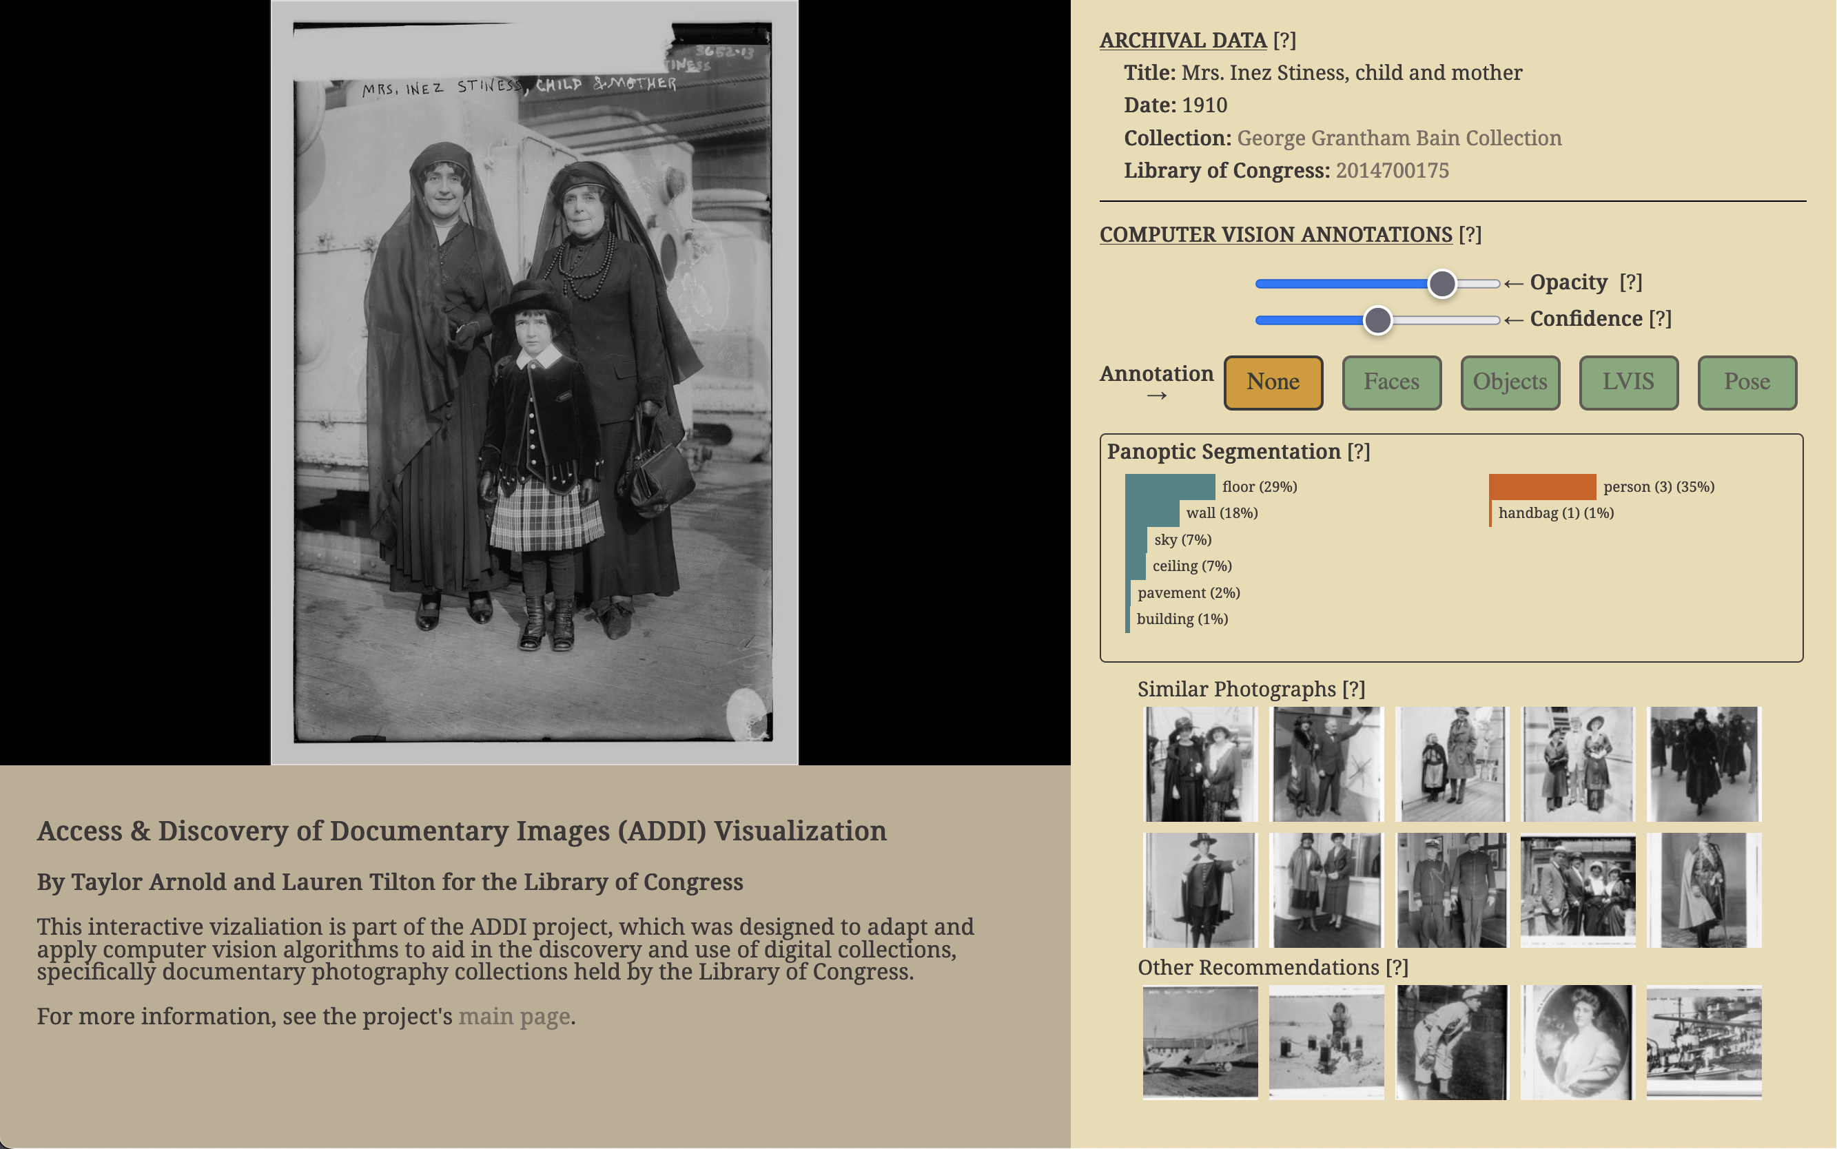
T. ARNOLD

Slide 6
T. ARNOLD

Slide 7
T. ARNOLD

Slide 8
T. ARNOLD

Slide 9
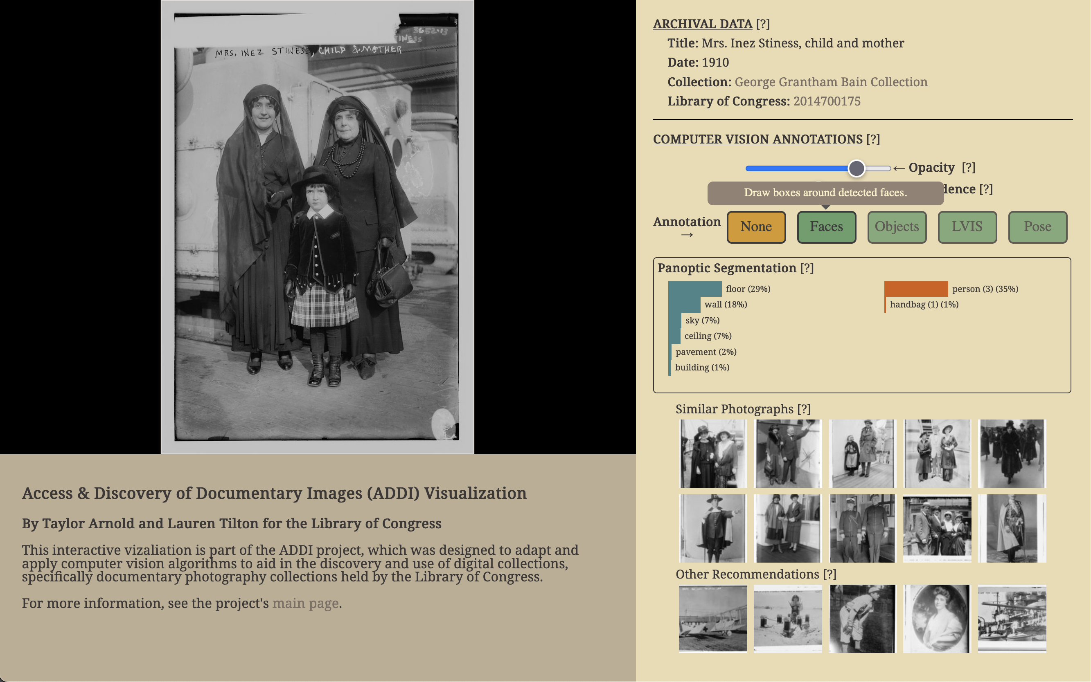
T. ARNOLD

Slide 10
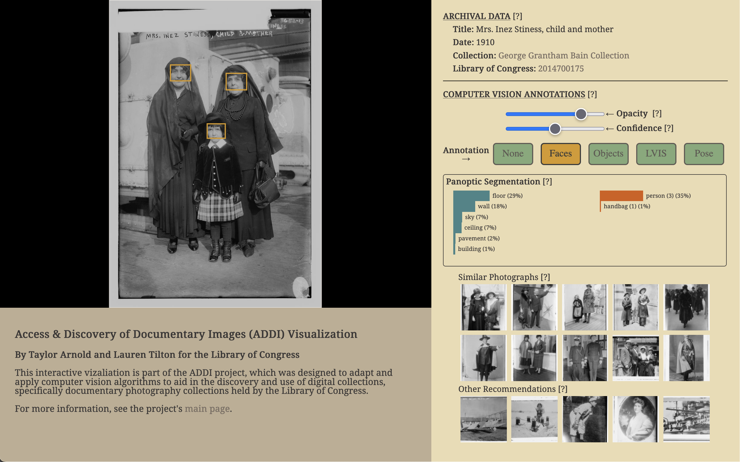
T. ARNOLD

Slide 11
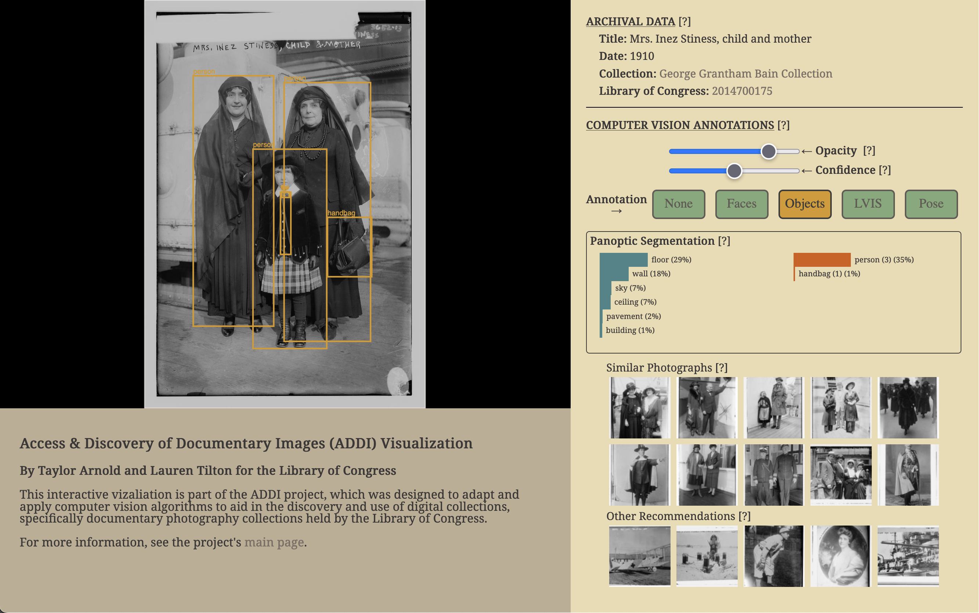
T. ARNOLD

Slide 12
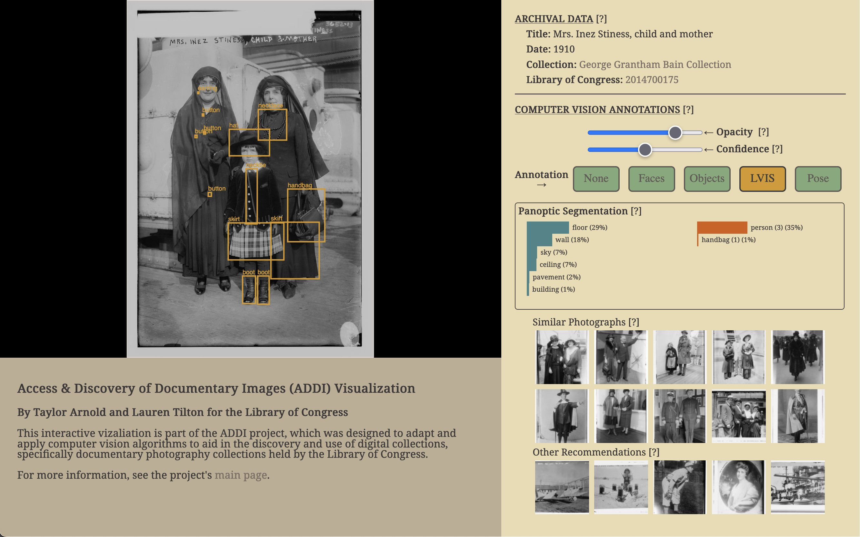
T. ARNOLD

Slide 13
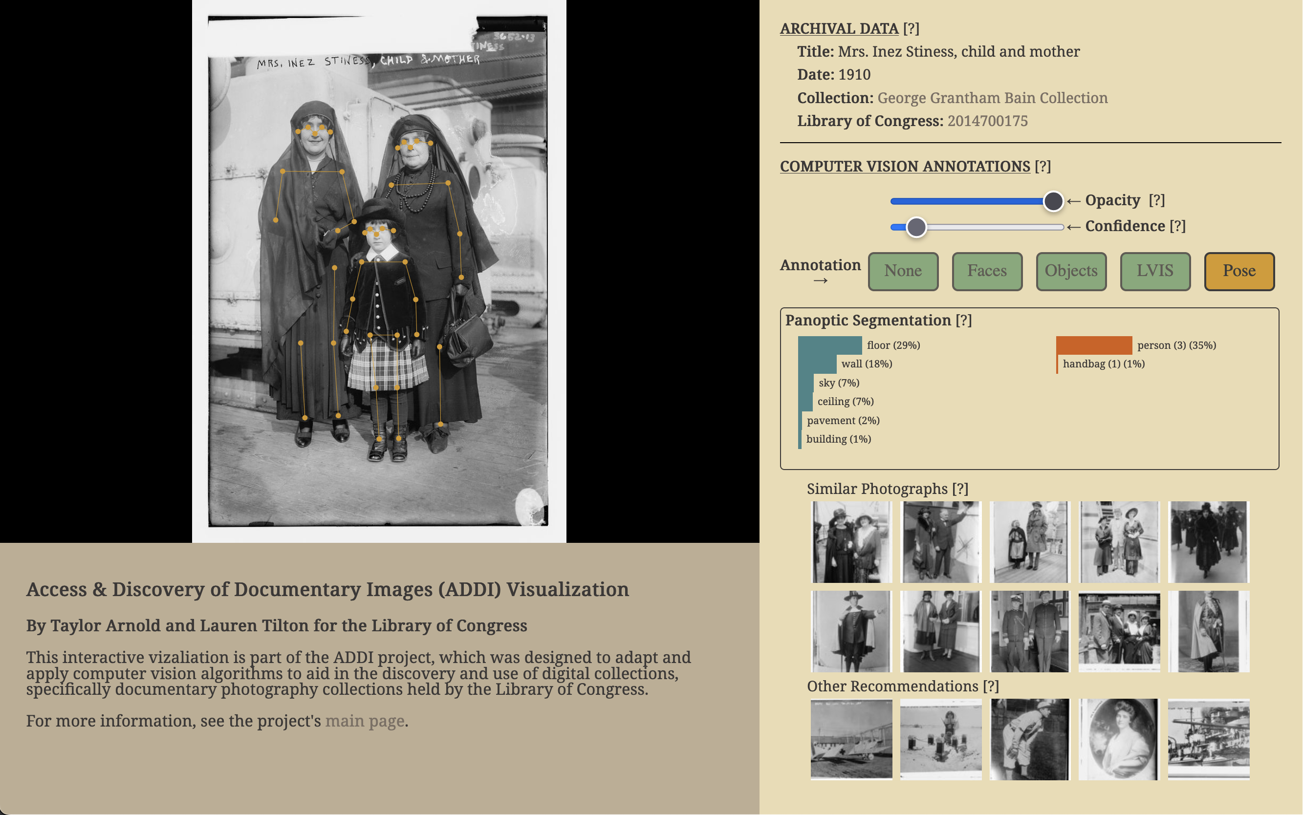
T. ARNOLD

Slide 14
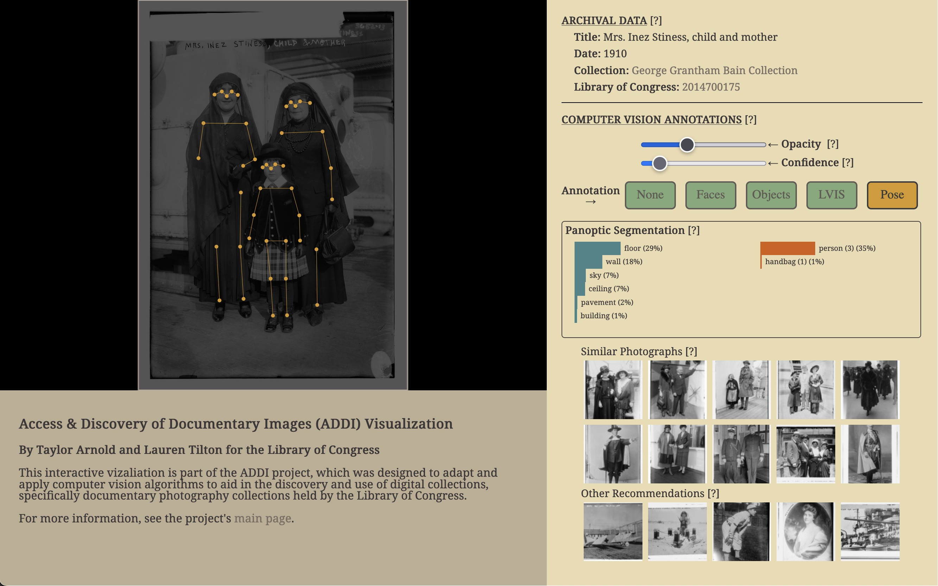
T. ARNOLD

Slide 15
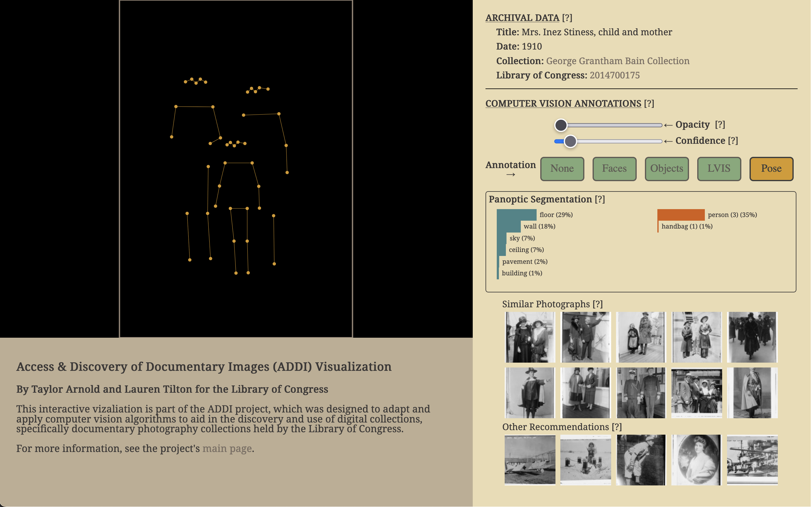
T. ARNOLD

Slide 16
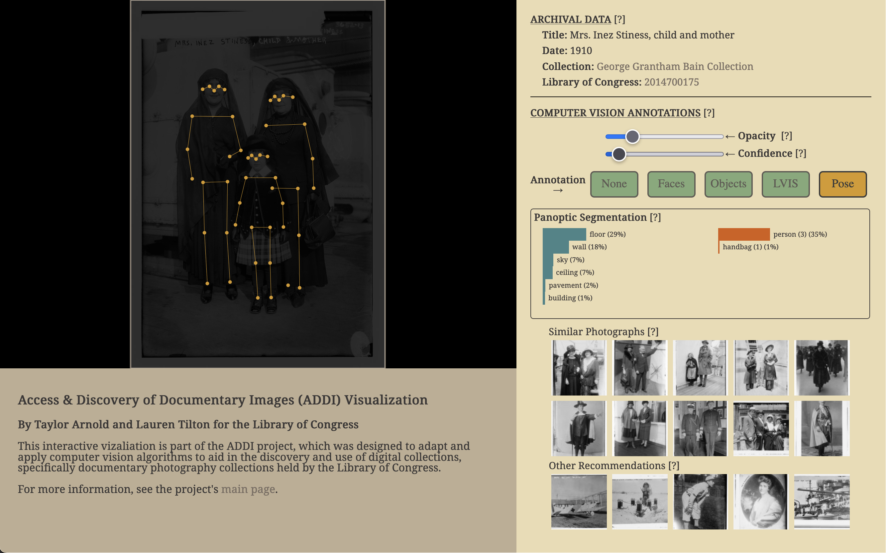
T. ARNOLD

Slide 17
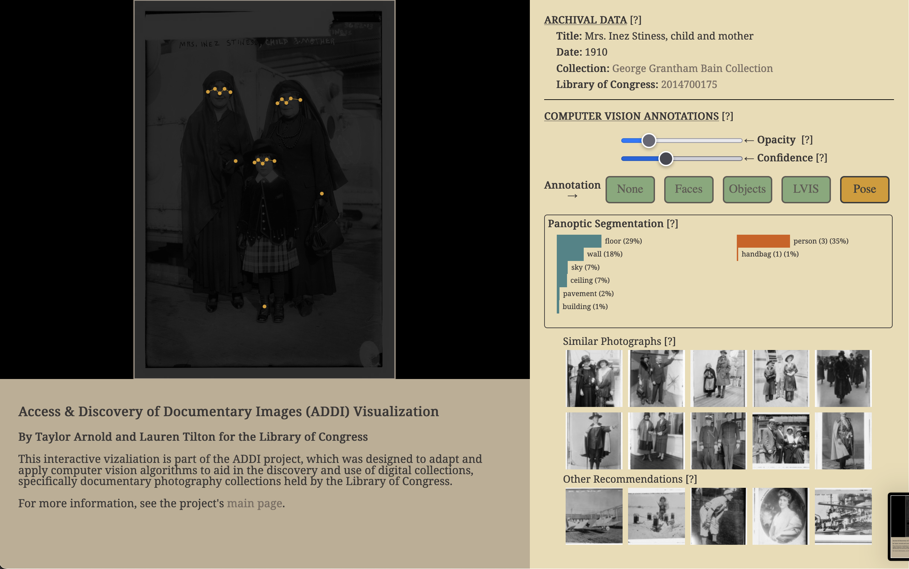
T. ARNOLD

Slide 18
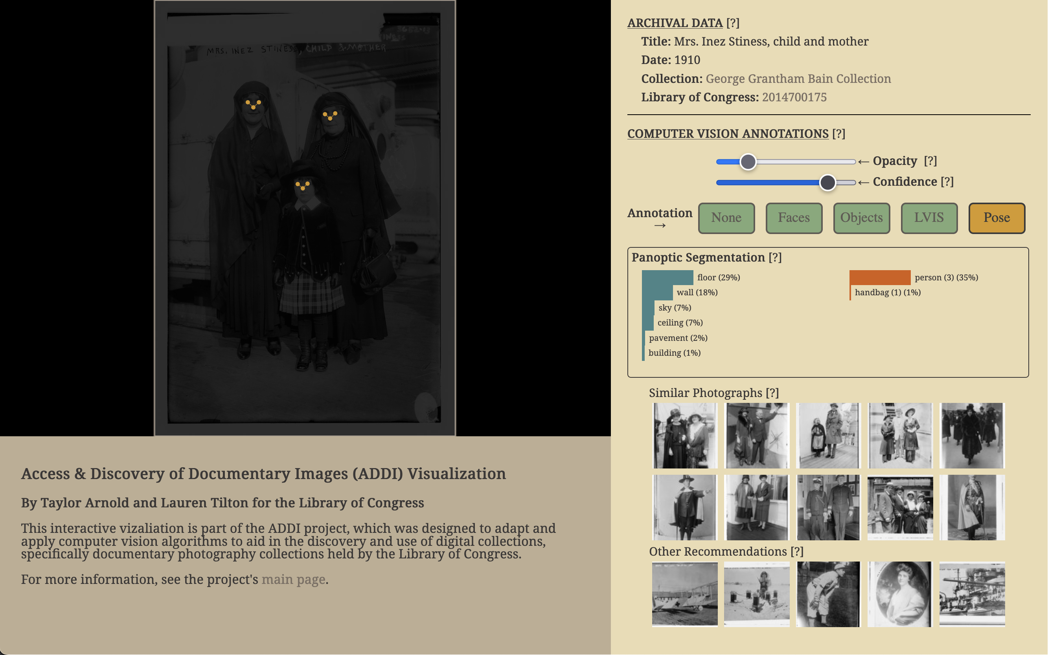
T. ARNOLD

Slide 19
T. ARNOLD

Slide 20
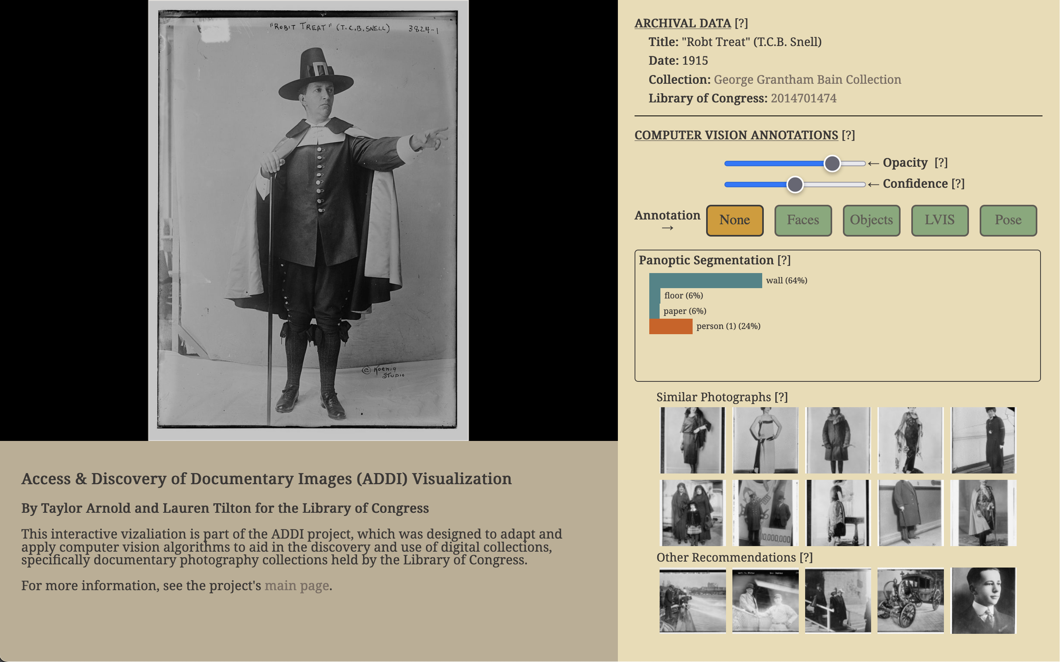
T. ARNOLD

Slide 21
Qualitative Analysis of CV
Computer vision research is dominated by the goal of optimizing numeric metrics such applied to standardized datasets. For applications that use CV methods as a starting point, we need to supplement quantitative measures with qualitative ones.
T. ARNOLD & L. TILTON

Slide 22
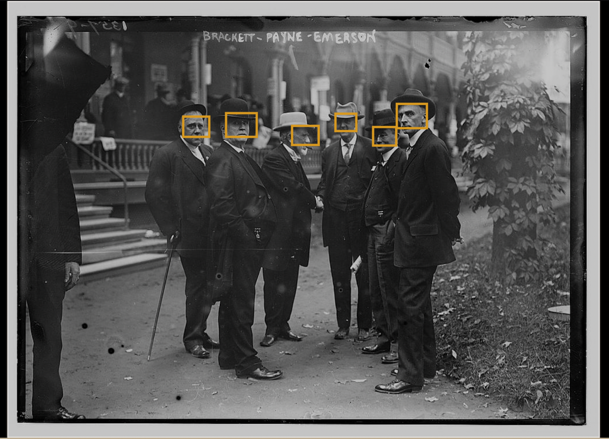
1. Face Detection
Example of results from a face detection algorithm, showing the ability to detect faces at different angles to the camera. [2014687262]
T. ARNOLD & L. TILTON

Slide 23
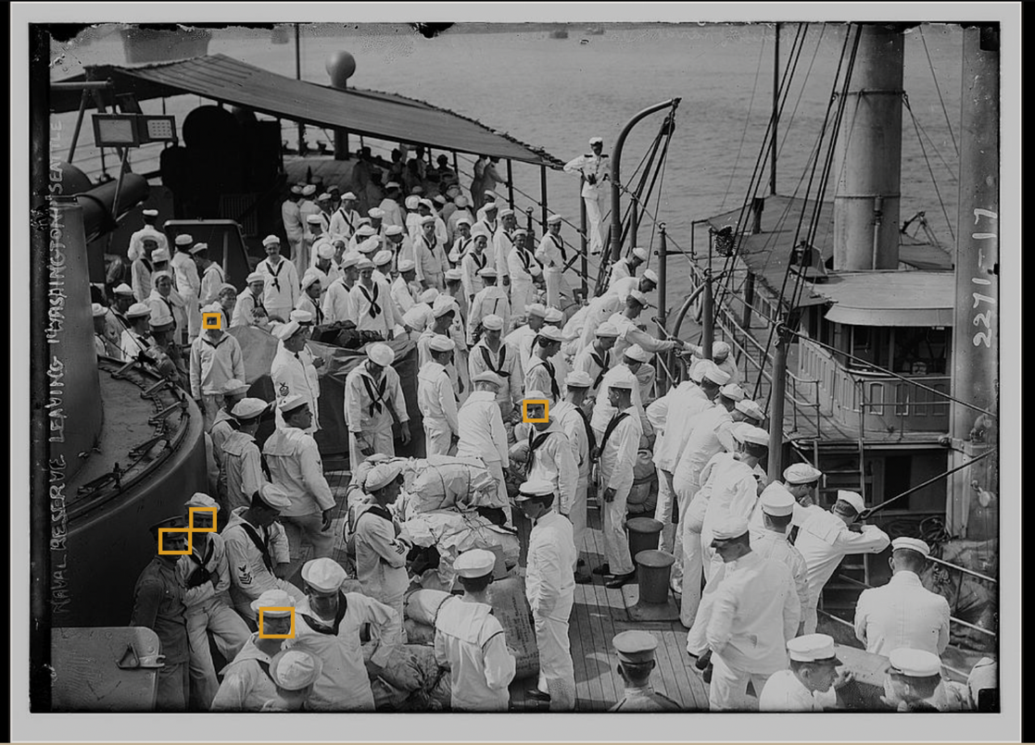
1. Face Detection
Example of results from a face detection algorithm, showing how only a subset of faces are picked up in a larger crowd. [2014689609].
T. ARNOLD & L. TILTON

Slide 24
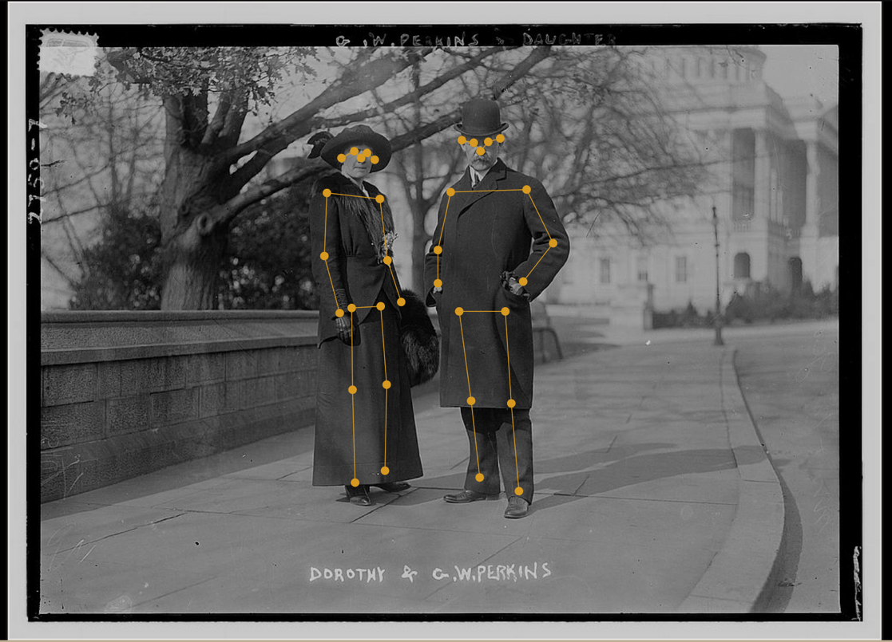
2. Pose Detection
Example of pose detection, showing good performance on a black-and-white image with people wearing period specific clothing. [2014693509]
T. ARNOLD & L. TILTON

Slide 25
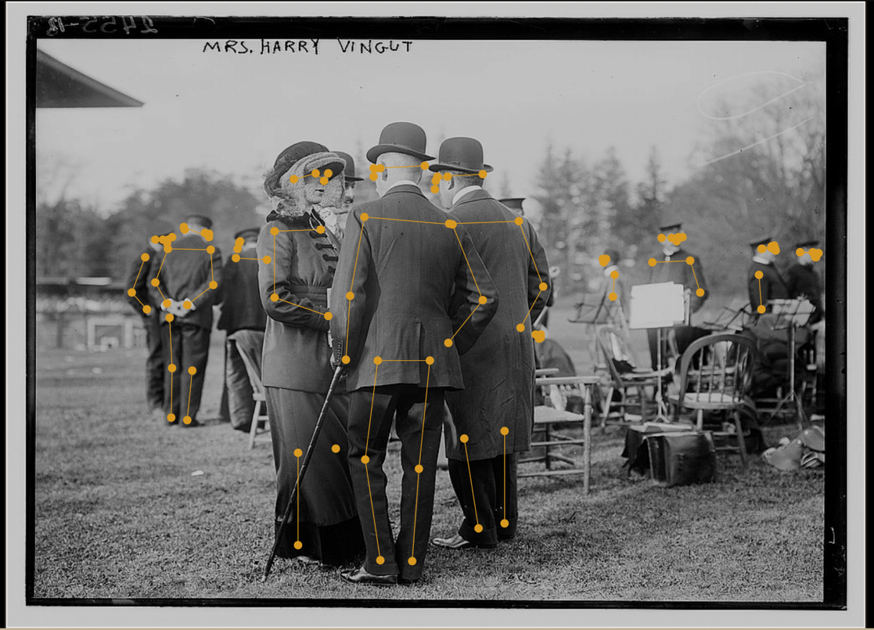
2. Pose Detection
Example of pose detection showing the ability to pick up people in the background. Notice, though, that the arm of the man in the right middle of the foreground’s arm in confused with the arm of the man in the middle of the frame. [2014690917]
T. ARNOLD & L. TILTON

Slide 26
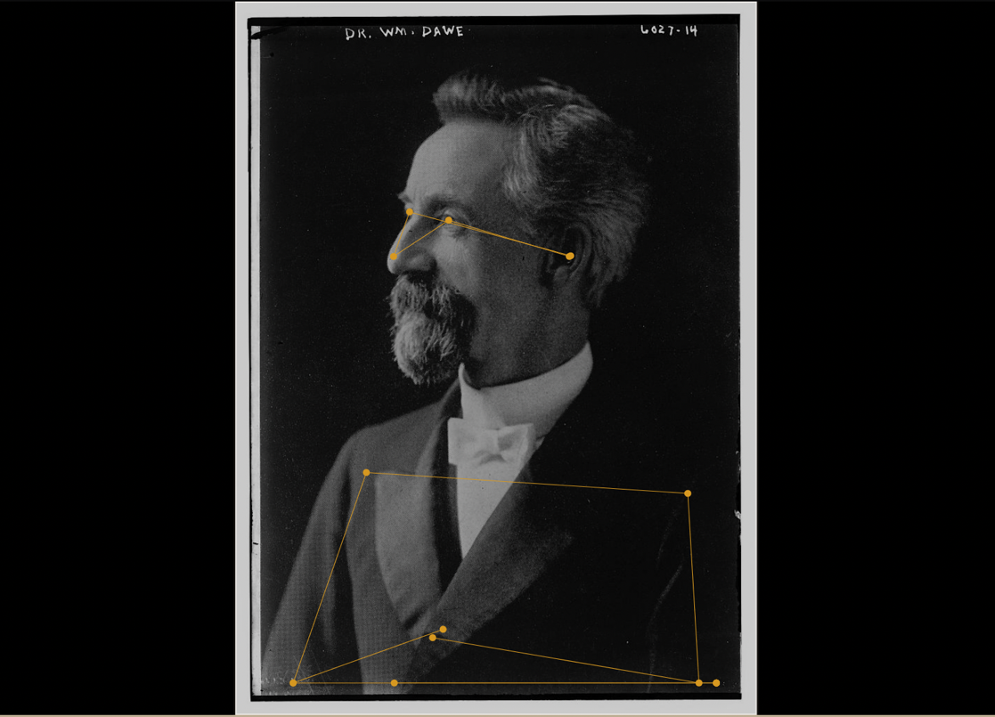
2. Pose Detection
Another example of pose detection. Notice that the algorithm trying to find the lower arms, torso and legs of the person shown only in portrait. The confidence score for the facial features is much higher than the lower features. [2014716249]
T. ARNOLD & L. TILTON

Slide 27
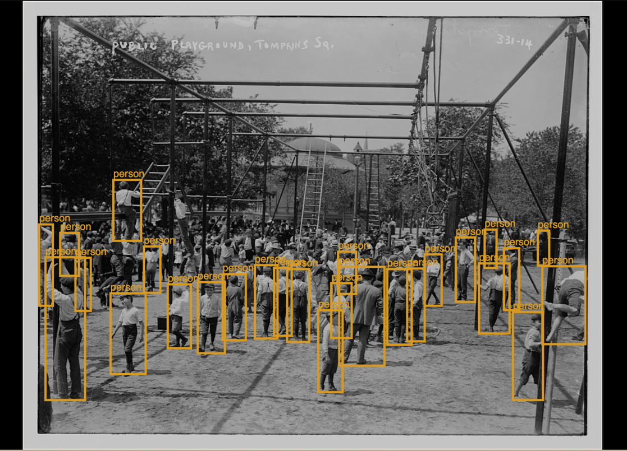
3. Object Detection
Object detection showing the people detected in a crowd. Notice that not all people are detected, but there are many people that are identified, even when obfuscated or very small. [2014681564]
T. ARNOLD & L. TILTON

Slide 28
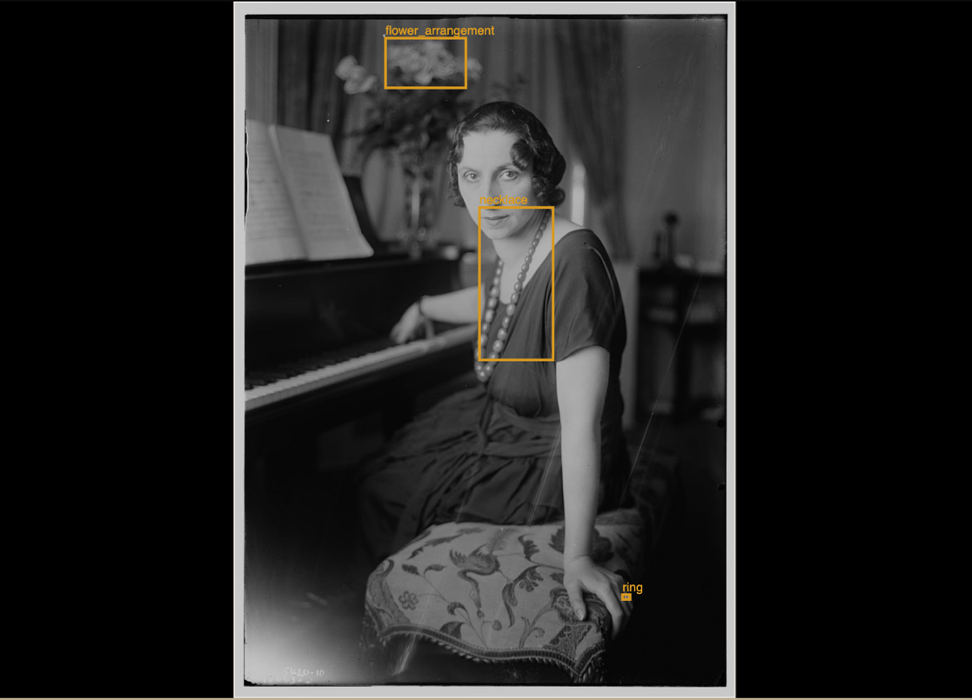
3. Object Detection
Example showing the LVIS image detection algorithm. It correctly identifies the flower arrangement, necklace, and ring in the historic black-and-white photograph. [2014712262]
T. ARNOLD & L. TILTON

Slide 29
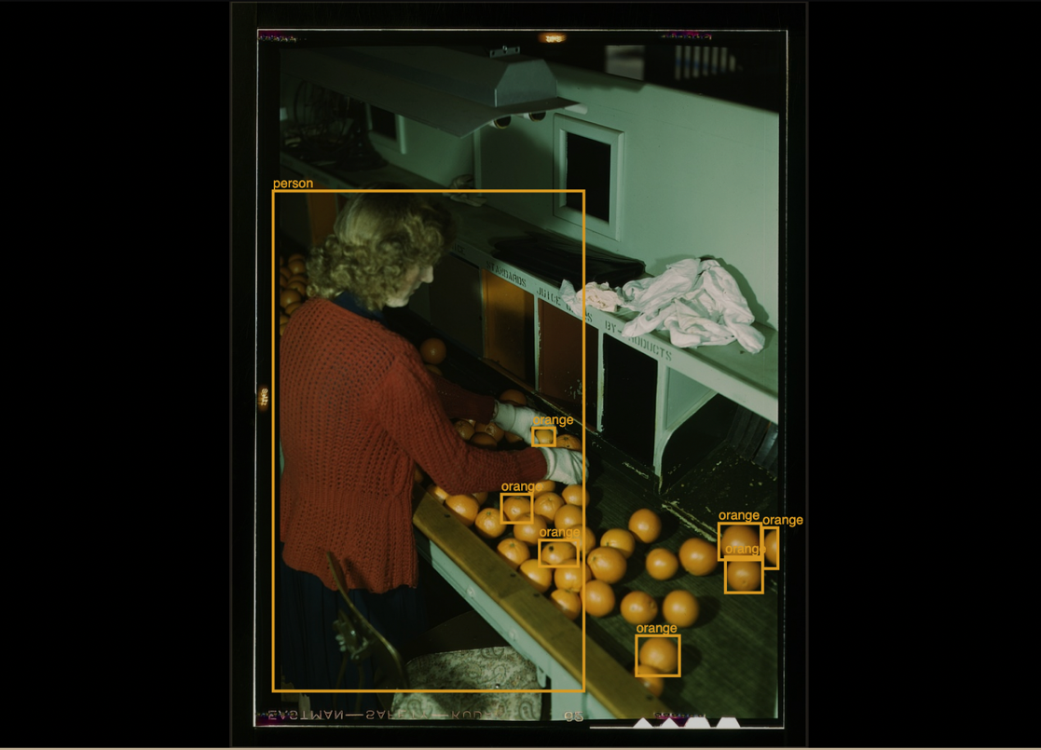
3. Object Detection
Object detection results on a color FSA-OWI image. It detects the person and some of the oranges, but most of the oranges are missed even when setting a very low confidence score. [2017878149]
T. ARNOLD & L. TILTON

Slide 30
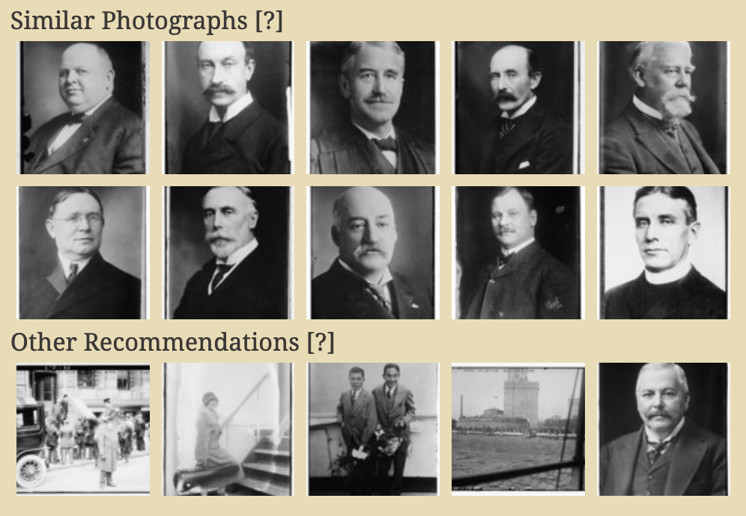
4. Image Similarity
Top two rows show the nearest neighbors to a starting image. It does a good job of finding similarly framed portraits in the collection. Bottom row shows five random recommendations from the collection for comparison. [2014686845]
T. ARNOLD & L. TILTON

Slide 31
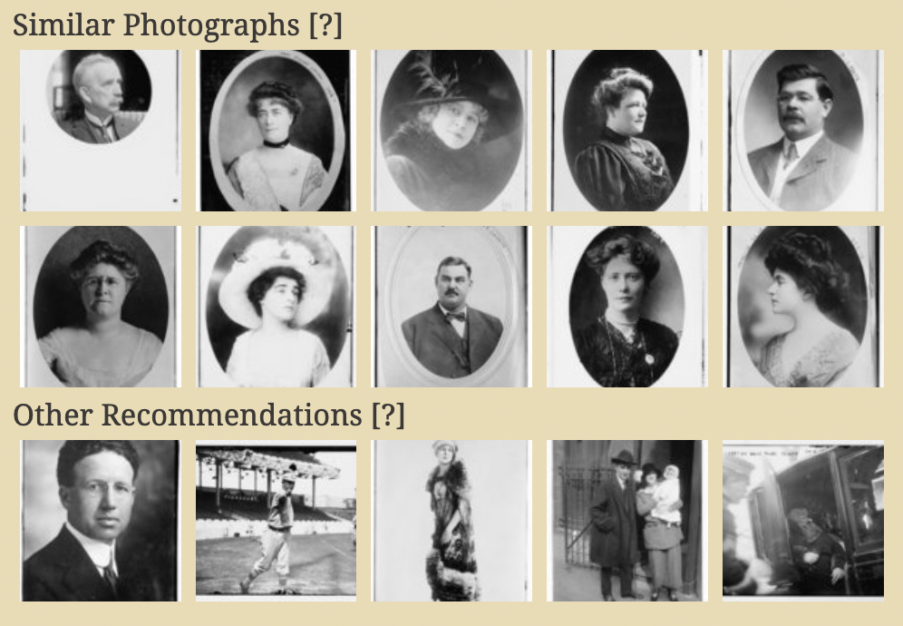
4. Image Similarity
Top two rows show the nearest neighbors to a starting image. Notice that the algorithm is heavily influenced by the round shape on the images. Bottom row shows five random recommendations from the collection for comparison. [2014684875]
T. ARNOLD & L. TILTON

Slide 32
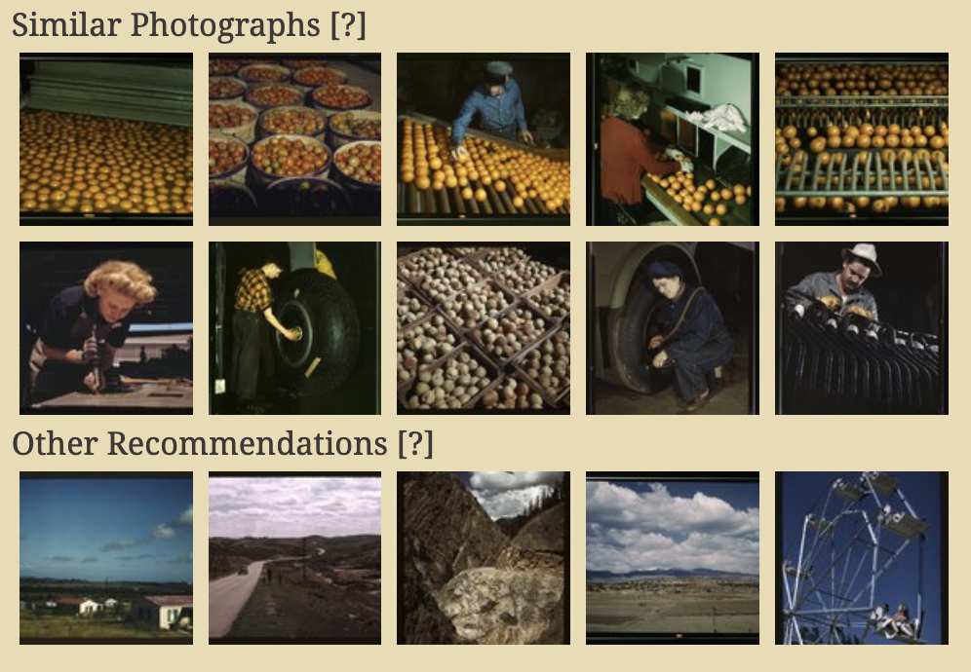
4. Image Similarity
Top two rows show the nearest neighbors to a starting image. It finds examples of other images with orange or other fruit. Bottom row shows five random recommendations from the collection for comparison. It is not entire clear how some of the images on the second row relate to the starting image. [2017878147]
T. ARNOLD & L. TILTON

Slide 33
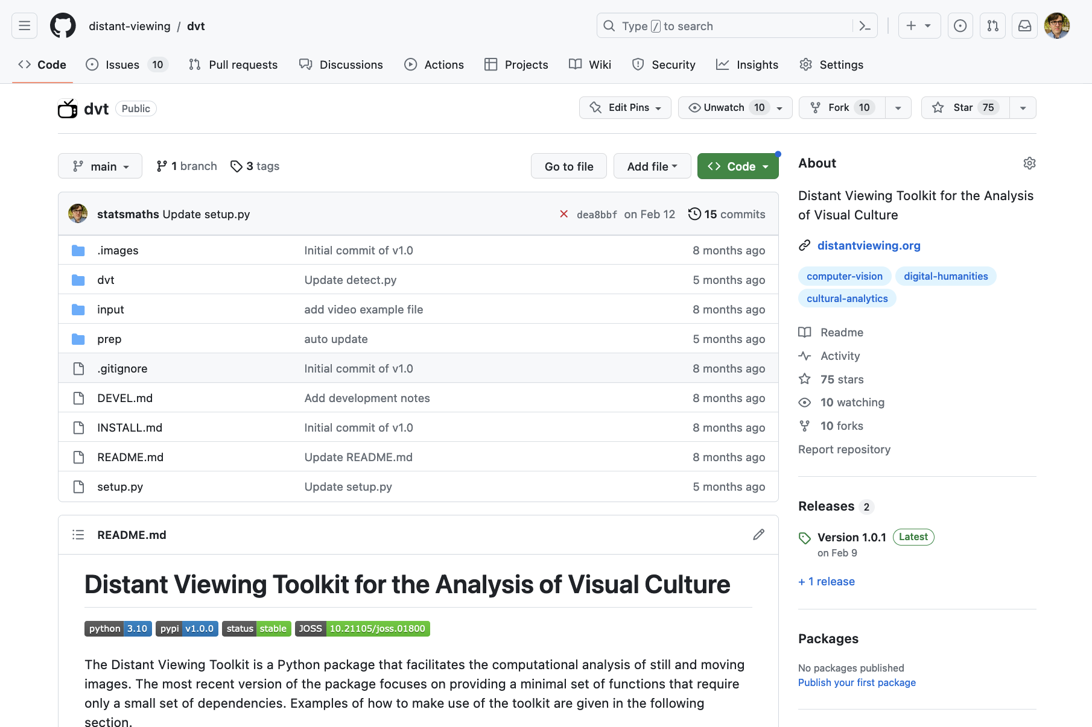
Future Steps
We are in the process of combining the ADDI platform from our collaboration with LC Labs with our Distant Viewing Toolkit software. The goal is to allow anyone to visualize their own collection of images using the same interface without having to setup any complex libraries and manually generate the annotations.
+
T. ARNOLD & L. TILTON

